Slide 1
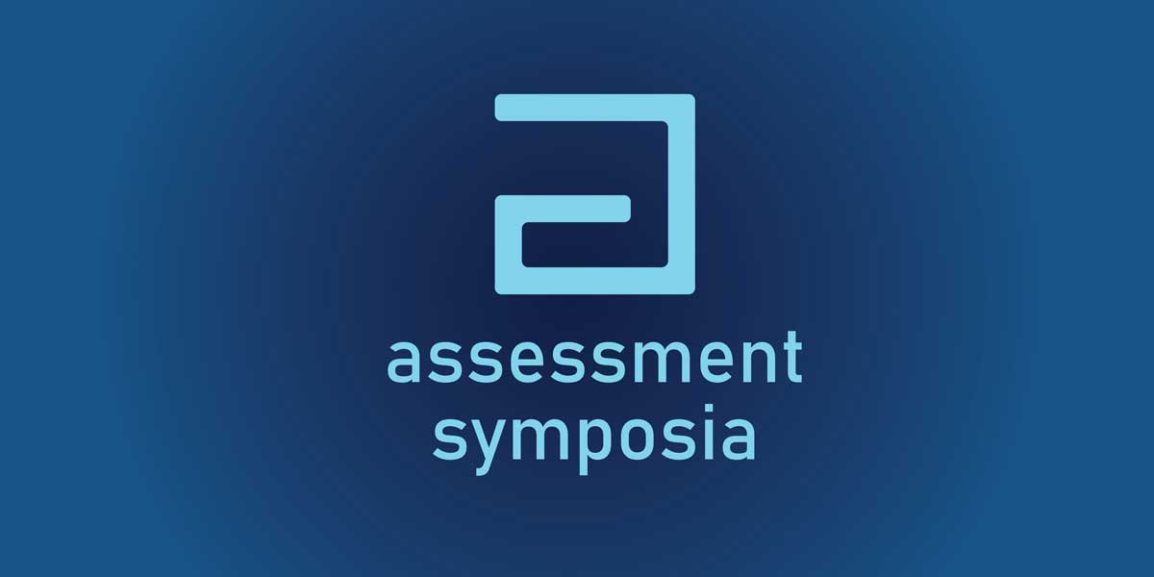

General Education Lunch and Learn
ABOR Assessment Results: Written Communication and Quantitative Reasoning

Slide 2
This Afternoon’s Schedule
1:30-1:35 Welcome
Lisa Elfring, Vice-Provost, Assessment, Teaching, & Technology
1:35-2:00 20 min session w/ 5 mins Q&A
“Optimizing Assessment Practices using Course Alignment and Mapping”
2:05-2:30 20 min session w/ 5 mins Q&A
“Assessing Graduate Students‘ Language Proficiency Development over Two Years”.
2:35-2:50 Coffee and Cookie Break & Poster Review
2:50-3:15 via Zoom 20 min session w/ 5 mins Q&A
“AME: UCATT Planning & Self-Study and ABET assessment of student
outcomes”
3:20-3:45 20 min session w/ 5 mins Q&A
“Viewing All Angles: Utilizing Unique Student Perspective for Formative Feedback”
3:50-4:15 20 min session w/ 5 mins Q&A
“Start Big and Get Small: Backward Design for Curriculum Development”
4:20-4:45 20 min session with 5 mins Q&A
“Piloting A Learner Self-Assessment in a Required 1st-year Course”
4:50-5:00 Wrap-up
Lunch (12:00-1:30)
Presentation and Discussion:
Results of the Arizona Board of Regents Tri-University General Education Assessments of
Written Communication
and
Quantitative Reasoning

Slide 3

A little history:
In 2019, ABOR updated their Policy on General Education for the 3 State Institutions
2020: Start of the Tri-University Assessment Committee
4 General education Outcomes
  Written Communication (2021-2022)
  Quantitative Reasoning (2022-2023)
  Critical Thinking (2023-2024)
  Civic Knowledge and American Institutions (2024-2025)
  Rinse and Repeat ☺

Slide 4
Assessment Goals
Overall Goal of Tri-University General Education Assessments:
Accountability: to measure student learning in the four areas identified by the Arizona Board of Regents
Improvement: to understand what can be done on individual campuses to support and improve teaching and learning in the four areas

Slide 5
Mapping ABOR General Education Policy 2-210 with the
Tri-University Written Communication Rubric
ABOR Written Communication Learning Outcomes | Tri-University Written Communication Rubric
Students will engage in civil discourse through writing. Students will be able to understand and use rhetorical skills. Students will demonstrate intellectual skills and habits of mind that define an educated person. | Context of and purpose for writing. The writer clearly and consistently defines a purpose that addresses a target audience and responds to a precise writing situation. The purpose, audience, and writing situation are carefully articulated through effective alignment of elements such as structure, language, and use of information.
Students will be able to communicate effectively through writing. Students will be able to understand and use rhetorical skills. Students will be able to demonstrate critical, innovative and creative thinking. | Content Development. Using narrative, description, analysis, critique, and/or synthesis, the writer formulates a knowledgeable and nuanced perspective about the selected topic. The writer integrates credible, sufficient, timely, and relevant evidence or sources that offer substantive support of the purpose.
Students will be able to communicate effectively through writing. Students will be able to understand and use rhetorical skills. | Conventions of Organization. The writer sustains purposeful attention to and applies genre or disciplinary features of organization in cohesive support of the writer’s purpose.
Students will be able to communicate effectively through writing. | Conventions of Syntax and Mechanics. The writer sustains precise attention to grammar, mechanics, and syntax in a manner consistent with the purpose, audience, and writing situation and that enhances the clarity of the writer's message.

Slide 6
Written Communication
The Process
Criteria | Accomplished [4] | Expanding [3] | Developing [2] | Emerging [1]
Context of and Purpose for Writing | The writer clearly and consistently defines a purpose that addresses a target audience and responds to a precise writing situation. The purpose, audience, and writing situation are carefully articulated through effective alignment of elements such as structure, language, and use of information. | The writer clearly defines a purpose, audience, and writing situation. There is alignment between the writing situation and most elements such as structure, language, and use of information. | The writer communicates a purpose, audience, and a sense of the writing situation, but evidence of awareness of these contextual features is inconsistent. There is minimal alignment between elements such as structure, language, and use of information. | The writer references a vague purpose, audience, or writing situation and relies on patterns or models that are not appropriate to the writing situation. The context and purpose are inadvertently reduced to the self.
Content Development | Using narrative, description, analysis, critique, and/or synthesis, the writer formulates a knowledgeable perspective, integrating diverse points of view about the selected topic. The writer integrates credible, sufficient, timely, and relevant evidence or sources that offer substantive support of the purpose. | Using narrative, description, analysis, and/or critique, the writer demonstrates a nuanced perspective of the selected topic. The writer discusses credible, sufficient, and relevant evidence or sources in support of the purpose. | Using narrative, description, and/or analysis, the writer demonstrates a developing, although perhaps inconsistent, understanding of the selected topic. The writer incorporates relevant evidence or sources that connect to purpose. | The writer demonstrates minimal understanding of the selected topic. The writer references or is informed by evidence or sources related to the purpose of the writing situation.
Conventions of Organization | The writer sustains purposeful attention to and applies genre or disciplinary features of organization in cohesive support of the writer’s purpose. | The writer demonstrates purposeful attention to features of organization consistent with genre or discipline in support of the writer’s purpose. | The writer presents an organizational strategy that is inconsistent with the genre or disciplinary features of structure in support of the writer’s purpose. | The writer illustrates an organizational strategy, but some features of organization detract from meaning and/or are not appropriate for the writing situation.
Conventions of Syntax and Mechanics | The writer sustains precise attention to grammar, mechanics, and syntax in a manner consistent with the purpose, audience, and writing situation and that enhances the clarity of the writer's message. | The writer develops grammar, mechanics, and syntax in a manner that clearly aligns with purpose, audience, and writing situation. | The writer uses grammar, mechanics, and syntax that convey purpose, audience, and context with a few instances where meaning is unclear. | The writer uses grammar, mechanics, and syntax with frequent instances that impede meaning and that sometimes do not align with purpose, audience, and context.
Notes:
Notes:
How the rubric was developed (Tri-uni efforts)
Who was involved—Aimee, EJ, me, Kathleen, Ryan, etc.
Getting scorers
Creating d2l site
Uploading into OAP
Calibration

Slide 7
Early career vs Late career
Early career
Less than 25 completed units
Directed self-placement for English
364 artifacts
Late Career
More than 75 completed units
Tier two Gen Ed courses
Upper division writing intensive courses
364 artifacts
Notes:
22 scorers
All artifacts read twice with a third read if difference within criterion was greater than one

Slide 8
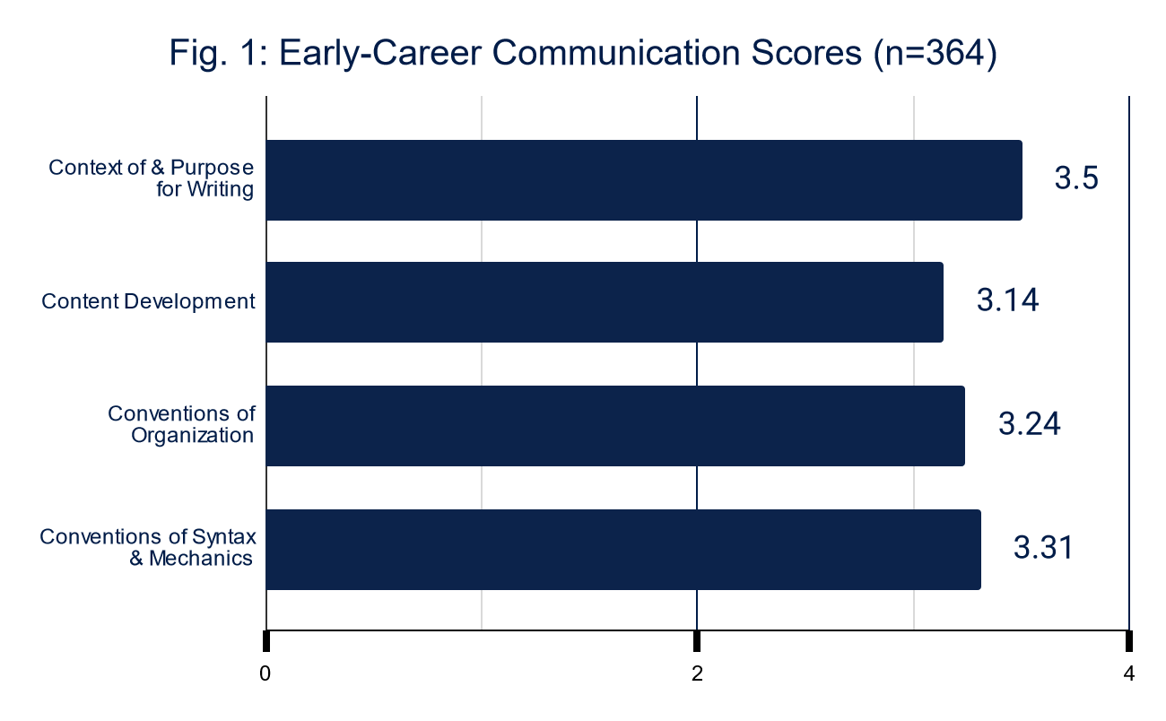
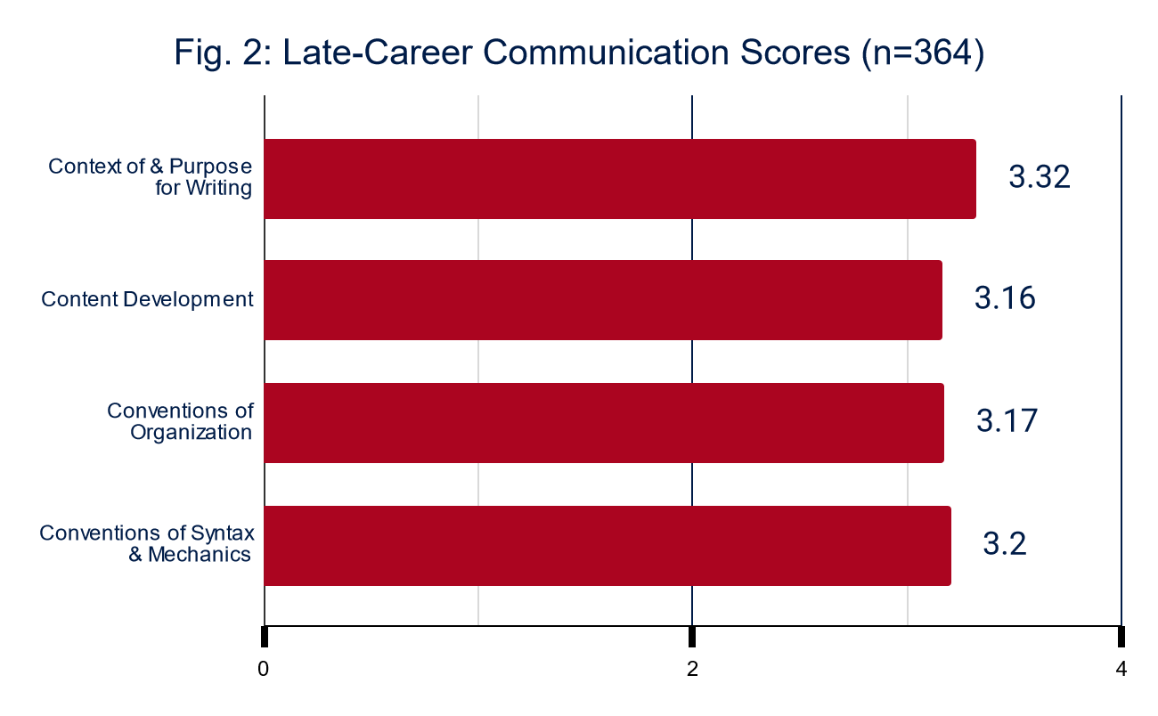

Slide 9
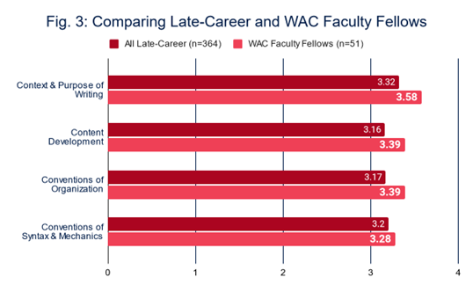
Samples from Classes Taught by Writing Across the Curriculum (WAC) Faculty Fellows
A small subset of late-career artifacts were collected from students enrolled in courses taught by instructors who participated in the 2021 Writing Across the Curriculum (WAC) Faculty Fellows training.
Across the Curriculum (WAC) Faculty Fellows training showed significantly stronger results (p = .02) in this assessment on two rubric dimensions (context and purpose of writing, conventions of organization).

Slide 10
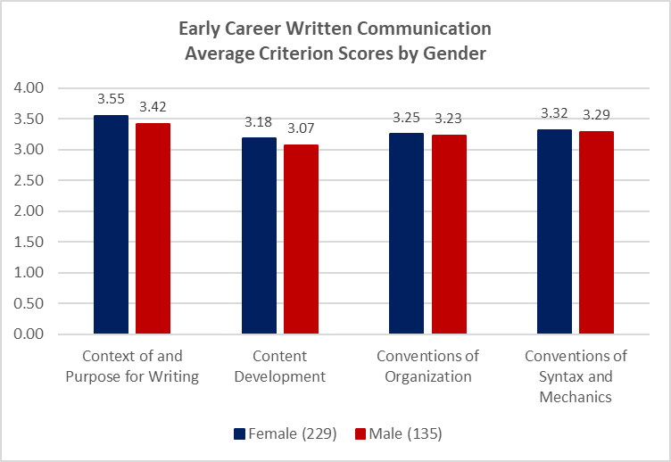
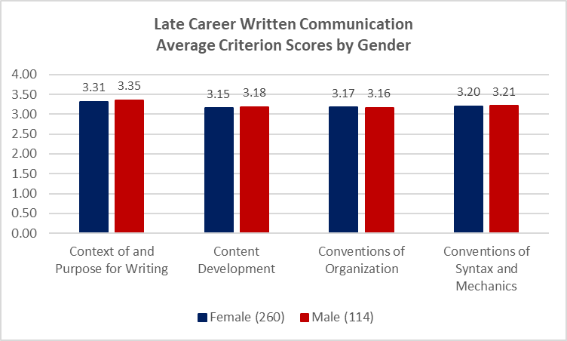
Gender

Slide 11
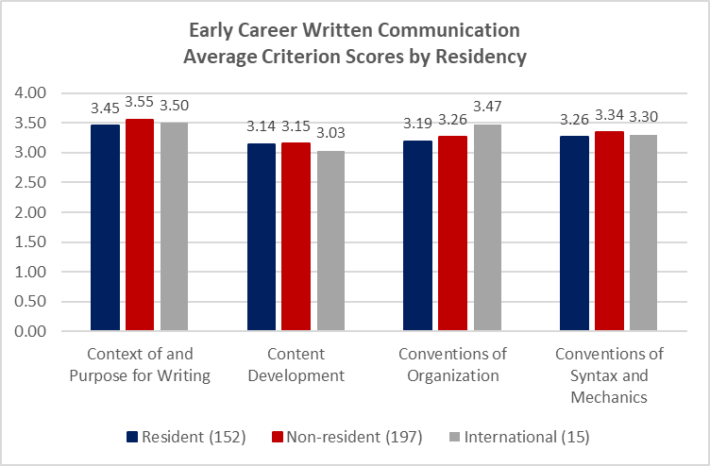
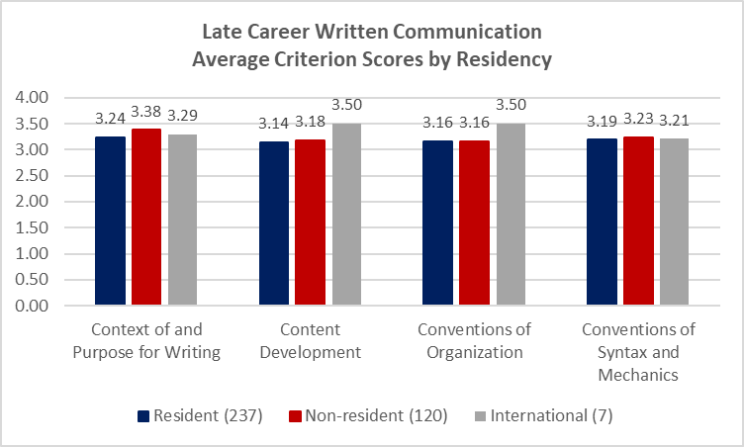
Residency

Slide 12
Findings and proposed Actions
Connected Curriculum
WAC Training
Guide students to recognize connections between writing experiences across Foundations Writing, General Education (GE) writing, and writing in the major.
Writing Across the Curriculum (WAC) scholarship provides a justification and rationale to advocate that undergraduate students complete two GE courses with a Writing Attribute.
Faculty need more training to expand what they can observe and explicitly name about writing expectations for students in their undergraduate courses.
An initial step to training should include a common lexicon for talking about writing that helps faculty define and explain specific features of writing.

Slide 13

Closing the Loop
WAC Campus Initiatives in Response to 21/22 Assessment
WAC Faculty Fellows
  WAC Faculty Fellows professional development had a direct impact on the writing assignments in numerous courses from fall 2021 to summer 2023.
  Over the course of two years, the program trained 12 faculty who taught courses enrolling 1,097 undergraduate students.
Embedded Tutoring
  Provide additional writing support in GE courses with the Writing Attribute.
  Our embedded tutors supported 15 courses (17 sections).
Targeted WAC Support for Department, Program, or Faculty
  Coalition of Writing
  WAC Newsletter
  5 Faculty Learning Communities
  Summer Coffee Chats
  4 Workshops
  Statement on AI Writing
This Photo by Unknown Author is licensed under CC BY-SA

Slide 14
Quantitative Reasoning

Slide 15
The UArizona faculty defined Quantitative Reasoning in the following way:
QR is the ability to draw logical conclusions from available quantitative information about a problem under study. It entails competence in critiquing, reflecting upon, and applying quantitative information (e.g. using numerical, graphical, tabular or symbolic representations) in the contexts of personal, professional and public life.

Slide 16
The UArizona Rubric
Competencies | Meets or Exceeds Graduation Expectations | Meets Current Level Expectations | Needs Improvement
Contextualize and Evaluate | Artifact extensively demonstrates why quantitative information is useful or needed in a given context. Artifact thoroughly demonstrates relevant assumptions, appraises the ethics of a study and/or methodologies used, evaluates the appropriateness of the approaches used, and assesses the potential relevance of the resulting quantitative information. | Artifact demonstrates the need for quantitative information, and evidence of contextual awareness is inconsistent. Artifact defines an assumption broadly and minimally demonstrates specific assumptions of a given context. Artifact describes methodologies used and minimally demonstrates how to evaluate their appropriateness. Artifact outlines the general relevance of a given quantitative approach and minimally links to the given context. | Artifact minimally demonstrates the need for quantitative information or its usefulness in a given context. Artifact minimally defines what an assumption is, is unclear on the methodologies or approaches used, and minimally discusses the potential relevance of resulting quantitative information.
Analyze, Visualize, and Quantify | Artifact extensively manipulates, organizes, classifies, and/or summarizes numerical information, which may or may not include gathering data, making predictions, doing calculations, and/or creating tables. Artifact extensively interprets and creates new numerical/visual representations of quantitative information. | Artifact manipulates, organizes, classifies, and/or summarizes numerical information. Artifact interprets existing numerical/visual representations of quantitative information (e.g. charts and graphs) and minimally creates new visual representations. | Artifact minimally manipulates, organizes, classifies, and/or summarizes numerical information. Artifact minimally interprets and creates the need for quantitative information or its usefulness in a given context.
Interpret and Apply | Artifact extensively demonstrates what the quantitative information suggests, summarizes important points or trends, and relates the quantitative information to the initial context or question and/or relates information to a broader idea, challenge or problem. Artifact revises and/or formulates ideas based on resulting analyses. | Artifact demonstrates what the quantitative information suggests, summarizes important points or trends, and minimally relates the quantitative information to the initial context or question and/or relates information to a broader idea, challenge or problem. Artifact revises previous ideas and minimally formulates new ideas based on resulting analyses. | Artifact minimally demonstrates what the quantitative information suggests, summarizes important points or trends, and minimally relates the quantitative information to the initial context or question and/or relates information to a broader idea, challenge or problem. Artifact minimally revises previous ideas and minimally formulates new ideas based on resulting analyses.
Communicate | Artifact includes extensive construction of explanations and/or arguments that are clearly supported by quantitative information and related interpretations. Artifact discusses the meaning and/or importance of resulting interpretations. Artifact compares and contrasts ideas that are backed by quantitative information and those that are not. Artifact produces and demonstrates various representations of quantitative information and references these aids in discussions. | Artifact includes construction of explanations and/or arguments that are clearly supported by quantitative information and related interpretations. Artifact discusses the meaning and/or importance of resulting interpretations, with a few inconsistencies. Artifact compares and contrasts ideas that are backed by quantitative information and those that are not, with a few inconsistencies. Artifact produces and demonstrates various representations of quantitative information and minimally references these aids in discussions. | Artifact minimally includes construction of explanations and/or arguments that are clearly supported by quantitative information and related interpretations. Artifact minimally discusses the meaning and/or importance of resulting interpretations, with a few inconsistencies. Artifact minimally compares and contrasts ideas that are backed by quantitative information and those that are not, with a few inconsistencies. Artifact minimally produces and demonstrates various representations of quantitative information and minimally references these aids in discussions.
Notes:
A collective of our faculty worked to create a modified VALUE rubric for Quantitative Reasoning

Slide 17
UArizona | NAU | ASU
Contextualize and Evaluate Assessing the relevance of data and its associated implications in a variety of contexts. | Assumptions Ability to identify and evaluate important assumptions in estimation, modeling, and data analysis. | Conceptualize Formulate hypotheses, mathematical models, and assumptions that are consistent with quantitative data.
Analyze, Visualize, and Quantify Working with quantitative information of various formats (e.g. graphs, data tables, equations). | Application/Analysis Ability to make judgments, make predictions, and draw inferences based on the quantitative analysis of data, while recognizing the limits of this analysis. | Application/Analysis Ability to manipulate quantitative data to pose and/or answer questions about society and/or nature while demonstrating an understanding of what variables, measurement and data are.
Interpret and Apply Critically analyzing quantitative information and generating ideas that are supported by quantitative evidence. | Interpretation Ability to explain information or phenomena presented in mathematical forms (e.g., equations, graphs, diagrams, tables, words). | Interpretation Evaluate arguments from everyday life or academic fields of study that are presented mathematically, statistically, computationally, or in visualizations.
Communicate Communicating those ideas and/or associated interpretations using various formats (oral presentations and/or written reflections). | Communicate Expressing quantitative evidence in support of the argument or purpose of the work (in terms of what evidence is used and how it is formatted, presented, and contextualized). | Communicate Communicate how quantitative data, interpretations, and or models are connected to outcomes, predictions, decisions, explanations, or future states. Employ one or more digital tools effectively to accomplish these outcomes.
Notes:
The UArizona version of the rubric is tailored for the students that attend our institution, and it aligns with the tri-university QR rubric themes and ABOR policy 2-210.

Slide 18
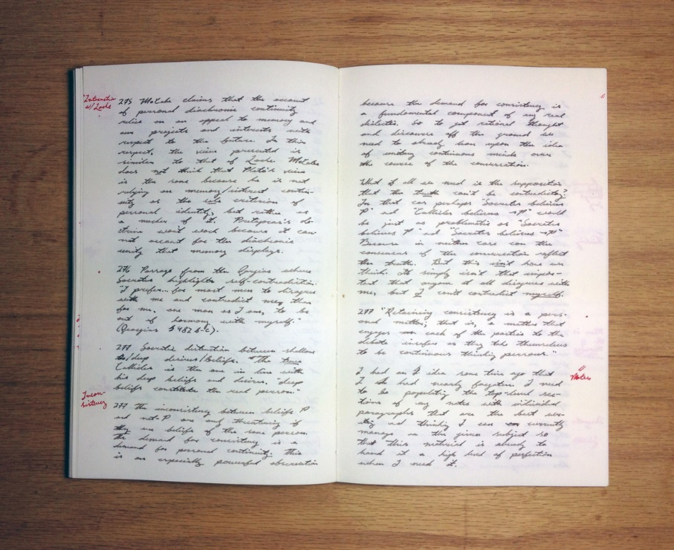
How was Student Work Assessed?
To ensure reliability, all reviewers were calibrated on the rubric prior to the scoring process.
Each artifact was evaluated twice, with a third reading taking place if the first two scores showed a difference greater than 1.
When reviewing the artifacts, if evidence of a particular criterion was not present, the scorer could mark n/a. In these cases, the artifact was not included in the average score for that criterion, explaining why the n for each criterion is different.
This Photo by Unknown Author is licensed under CC BY-SA

Slide 19
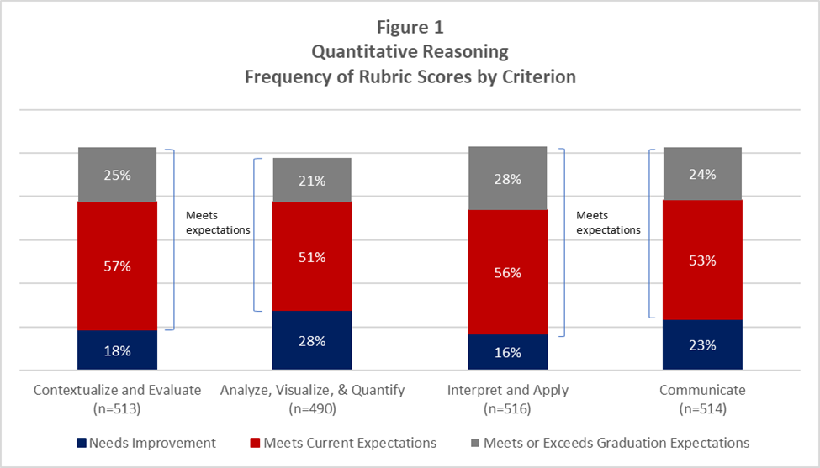
What Did We Learn?
It is clearly evident by these data that most of the students are meeting current or graduation expectations.
These findings are aligned with other similar, rubric-based QR assessments done by other institutions. (Texas A&M, 2022; University of North Dakota, 2015; University Kentucky, 2012

Slide 20
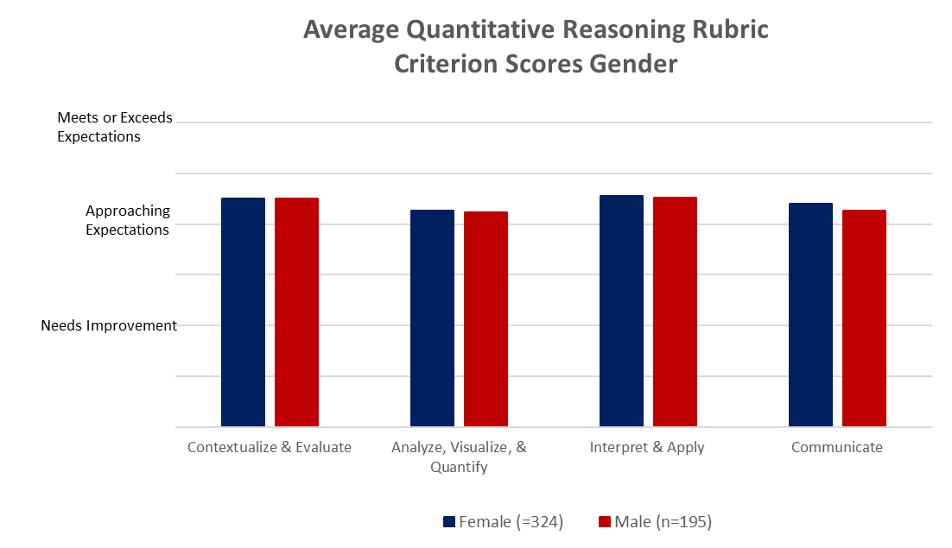
Gender

Slide 21
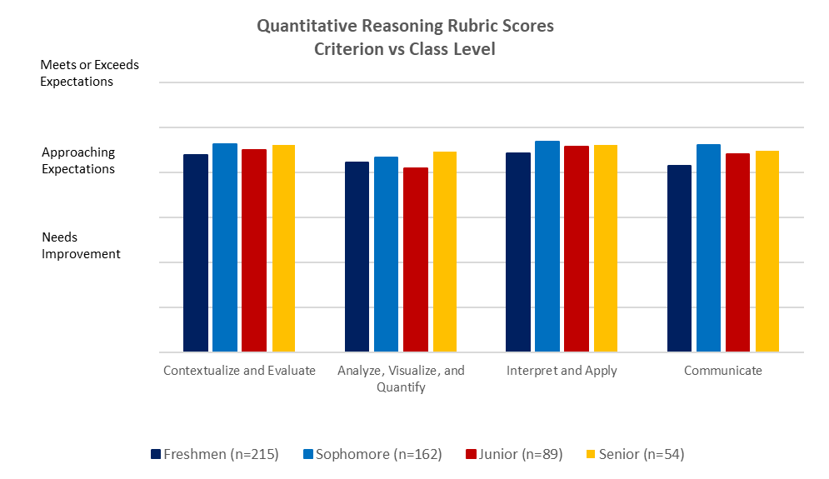
Class

Slide 22
Findings and Possible Actions
Offering workshops on writing effective signature assignments in quantitative reasoning, especially emphasizing analyzing, visualizing, and quantifying data.
Developing Faculty Learning Communities based on best practices in teaching quantitative reasoning.
Launching a “quantitative reasoning across the curriculum” initiative with faculty leadership, similar to the successful writing across the curriculum (WAC) initiative.
Because our general education curriculum is fairly new and these samples were collected during the first year of implementation, we consider these findings to be a baseline for future assessments.
Some initiatives that we should consider moving forward include:

Slide 23

Critical Thinking
Written Communication (2 yr check)
Continue WAC Efforts
Develop professional development opportunities for Quantitative Reasoning (e.g. Signature Assignments)
Work on developing Civics assessment
Next Steps

Slide 24


For more information about General Education: https://gened.arizona.edu/
Thank you!
Elaine Marchello, Director of GE Assessment
evm@arizona.edu
Susan Miller-Cochran, Executive Director of General Education
millercochran@arizona.edu
Emily Jo Schwaller, Assistant Director, Writing Across the Curriculum
emilyjoschwaller@arizona.edu
This Photo by Unknown Author is licensed under CC BY-NC

