Slide 1
Viewing All Angles
Utilizing the Unique Student Perspective for Formative Feedback
Rebecca Pérez
Assistant Director, Instructional Data

Slide 2
Today, we’ll discuss
Value of Student Feedback
Understanding and Using the Feedback
Building a Complete Picture

Slide 3
Types of Feedback
Formative
Student Feedback
Long-term exposure to class
Intended for improving teaching quality
What aided learning and where areas of confusion remain
Summative
Peer Observation
Snap-shot, single instance
Content knowledge and teaching methods assessment
Grades
Learning Outcomes

Slide 4
Value of Student Feedback
Why student voice is important
Learner’s perspective
Activities, interactions, clarity
Active participant in their learning
Learner confidence, self-reflection

Slide 5
Understanding & Using Student Feedback
What Students Are Asked
How Data is Reported
Look at the Big Picture
Identifying Areas for Change

Slide 6
Student Course Surveys
Targeted Dimension of Teaching | SCS items
Students are actively engaged in learning | In this course, I was encouraged to participate through class activities, projects, and/or assignments.
Builds upon students’ prior knowledge and experience | This course expanded my knowledge and skills in this subject matter.
Promotes and supports student diversity | I was treated with respect in this course.
Supports students’ conceptual understanding | I was encouraged to analyze and/or apply the concepts and skills taught in this course.
Makes explicit learning outcomes | The learning objectives for this course were clear to me.
Uses links between disciplinary and/or inter-disciplinary theory and practice | This course helped me to connect the concepts and skills we learned to the world around me.
Uses learning environments, resources, techniques effectively | I feel I learned the subject matter well enough to help another student in this course. The course materials (D2L site, assigned readings, presentations, activities, etc.) helped me learn in this course.
Presents material in an appropriately structured manner | Course materials, procedures, and deadlines were clearly organized.
Seeks feedback on students’ understanding and responds appropriately | I regularly/frequently had the opportunity to ask questions about concepts and skills in this course.
Provides timely feedback on student work/progress | I received feedback on my course work/assignments throughout the semester. I received feedback on course work/assignments that helped me learn.
Overall student experience
Open-ended Questions: | What did you especially like about this course? What suggestions would you make to improve the way this course? Please write any additional comments you may have below.

Slide 7
Data Presentation
SCS Response Statistics: 45 of 91 (49.45%) students responded
Term | Class | Instructor | Delivery
Spring 2024 | SCS-301-001-12345-LEC | Wildcat, Wilbur | In Person
1) I was treated with respect in this course.
Response Text | Response Value | Frequency | Response Percent
strongly agree | 5 | 41 | 91.11%
agree | 4 | 4 | 8.89%
uncertain | 3 | 0 | 0.00%
disagree | 2 | 0 | 0.00%
strongly disagree | 1 | 0 | 0.00%
No Response | 0 | 0 | 0.00%
What is reported:
Response Frequencies
Percent Agreement
Changes Over Time
Optional Text Analysis
2) In this course, I was encouraged to participate through class activities, projects, and/or assignments.
Response Text | Response Value | Frequency | Response Percent
strongly agree | 5 | 40 | 88.89%
agree | 4 | 5 | 11.11%
uncertain | 3 | 0 | 0.00%
disagree | 2 | 0 | 0.00%
strongly disagree | 1 | 0 | 0.00%
No Response | 0 | 0 | 0.00%

Slide 8
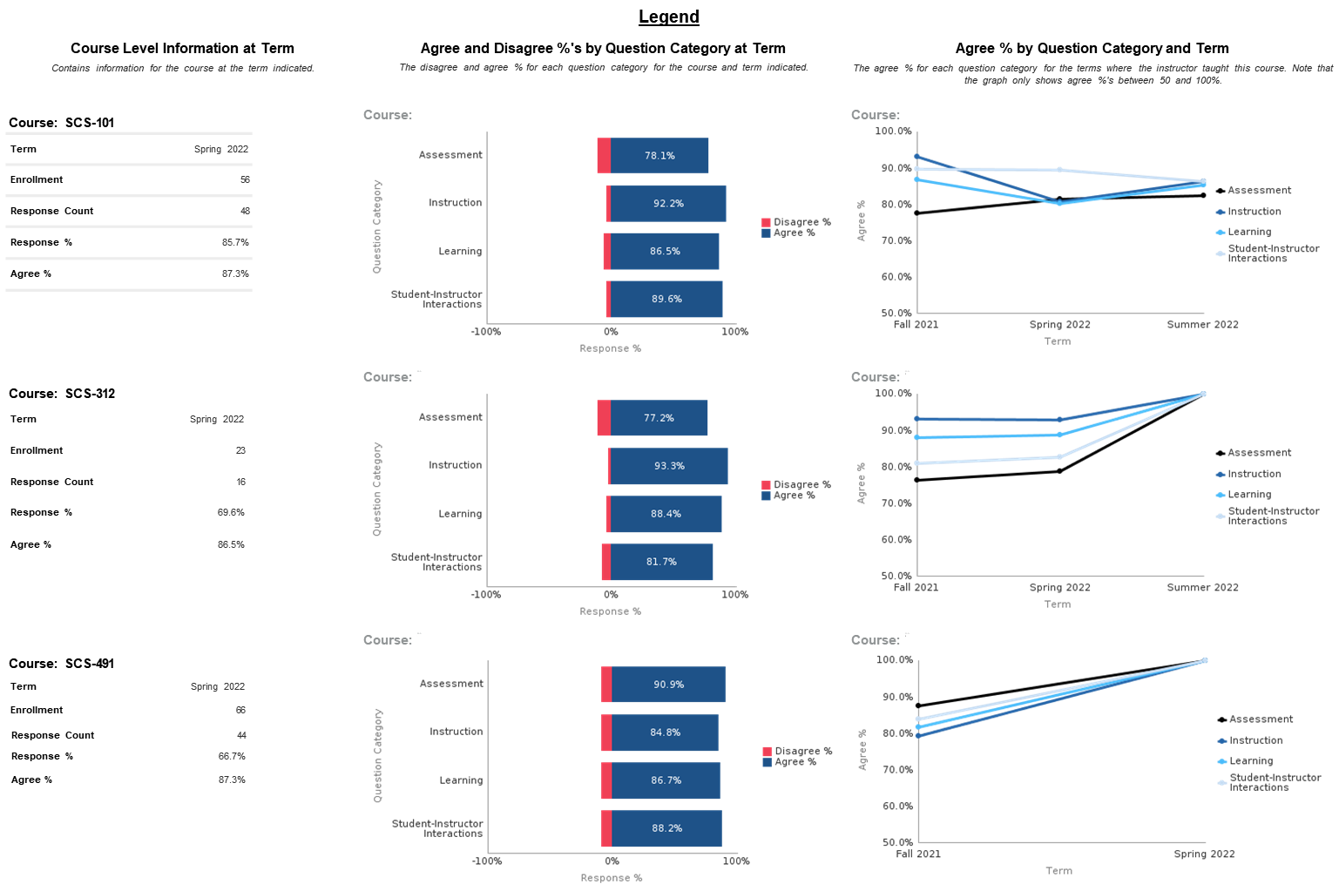
What’s Trending

Slide 9
SCS Item Categories

Slide 10
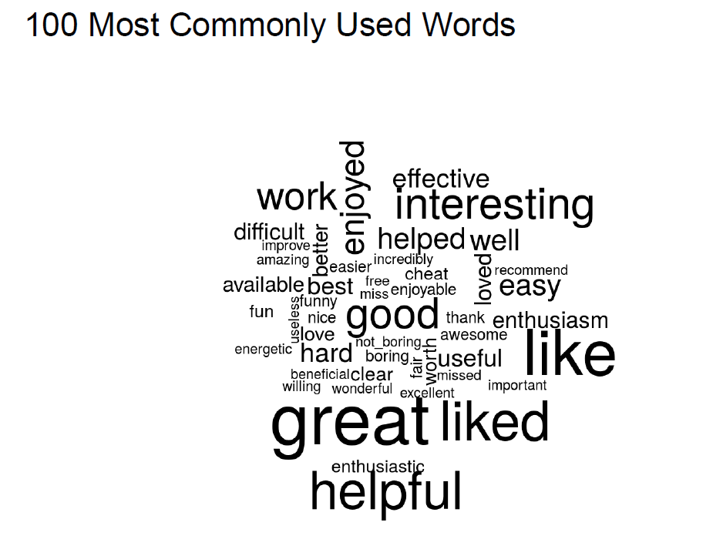
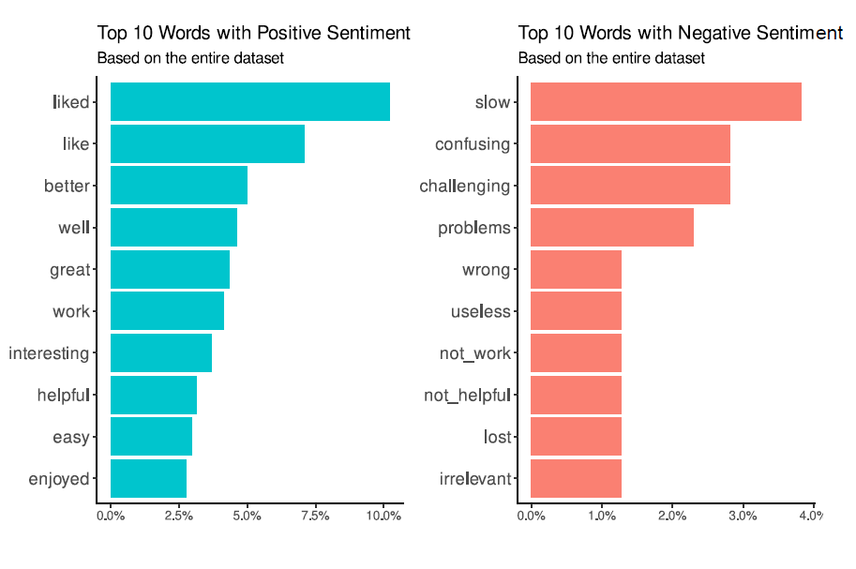
Sifting Through the Comments

Slide 11
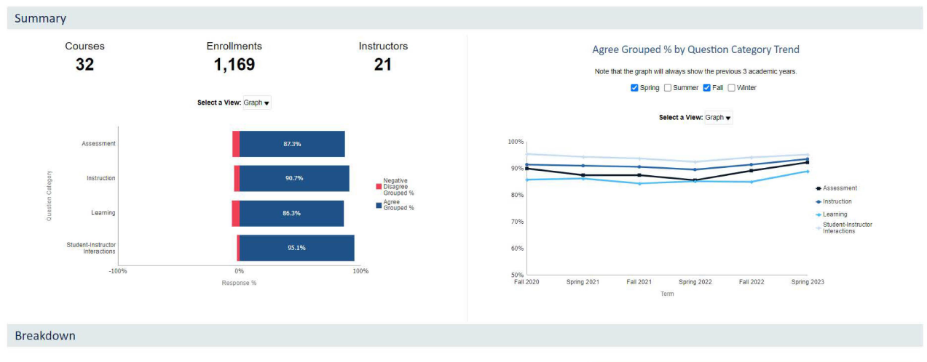
SCSs & Program Assessment
Can be correlated other assessment measures like:
Grades
Learning outcomes

Slide 12
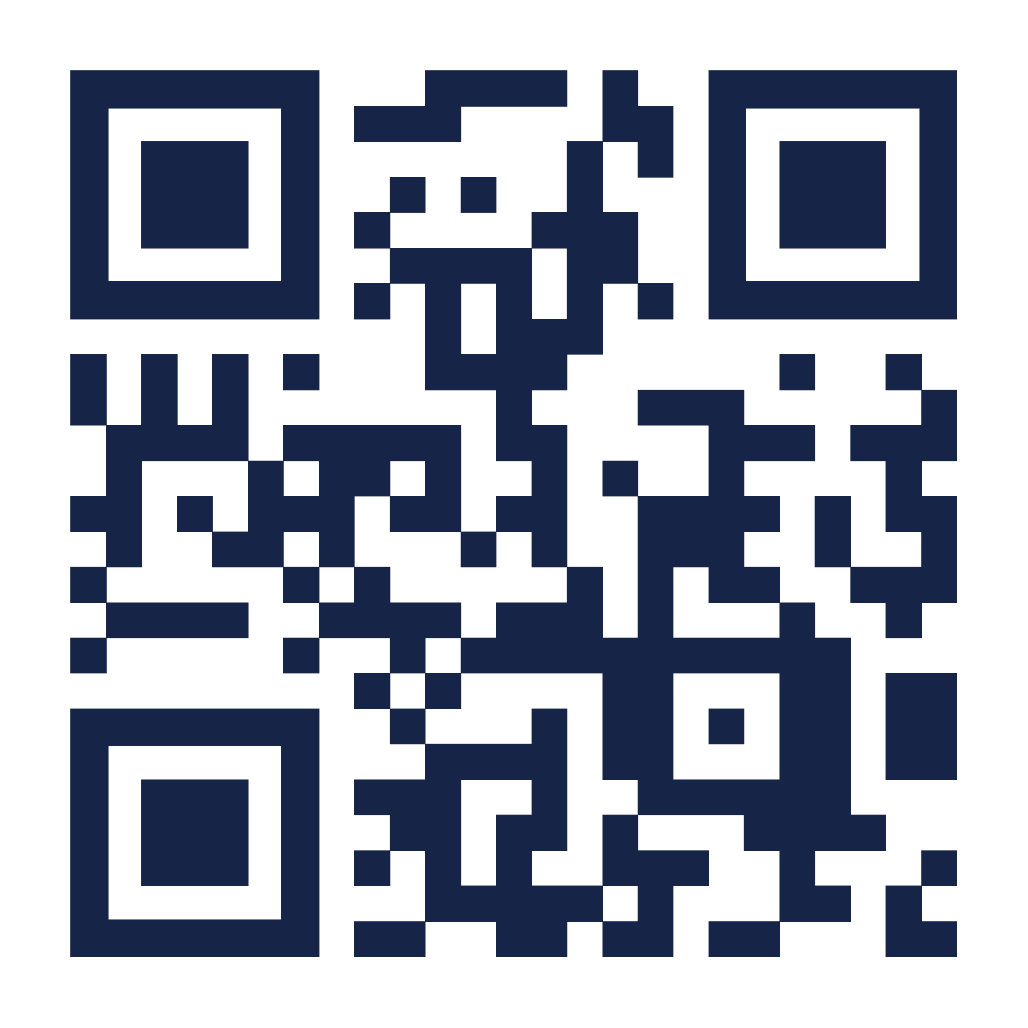
Integrated Learning Center, 103
1500 E. University Blvd
(520) 626-0536
ucatt.arizona.edu
Notes:
UCATT Contact Information with Image

