Slide 1

Graduate Students‘ Language Proficiency Development over two Years
Peter Ecke
University of Arizona
eckep@arizona.edu
Erwin Tschirner
University of Leipzig
tschirner@uni-leipzig.de
Assessment Symposia, The University of Arizona, April 24, 2024

Slide 2
Project planning started in 2018/2019 (I was Interim Director of Graduate Studies)
  MA in German Studies
  International Ph.D. Program in Transcultural German Studies with Universität Leipzig and Universität Köln, Germany
A longitudinal study
investigating how graduate students in German develop their L2 proficiency over two years
using standardized ACTFL proficiency exams, self-assessments and interviews

Slide 3
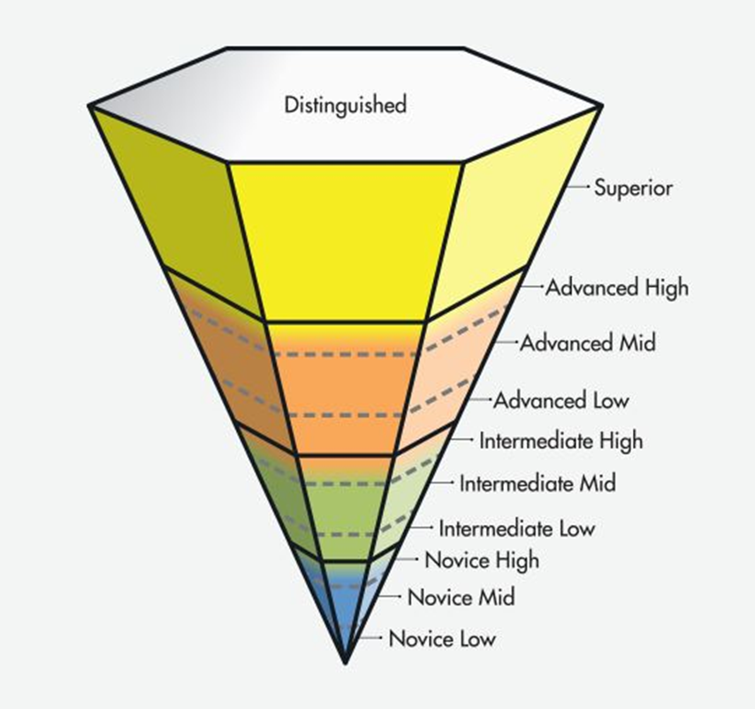
Background: Language proficiency research
Average language proficiency after 4 years of undergraduate study
  Speaking (OPI/OPIc): Intermediate High (IH)
  Reading (RPT): Intermediate High (IH)
  Listening (LPT): Intermediate High (IH) (Tschirner, 2016, 2018)
Only half of German language teacher candidates reach the standard Advanced Low (AL) in OPIs
(Glisan et al., 2013; ACTFL/CAEP, 2013).
Most language teachers maintain or increase their oral proficiency (AL+)
(Bell & Borden, 2022; Leonard & Bonilla, 2022).
Notes:
Advanced Low (AL) for French, German, Hebrew, Italian, Portuguese, Russian, and Spanish, or Intermediate High (IH) for Arabic, Chinese, Japanese, and Korean on the official
ACTFL OPI

Slide 4
Rationale for research
Proficiency development during graduate study: under-researched
The expectation: Students enter/leave graduate programs of language and culture with an advanced L2 proficiency, and they develop their L2 skills further.
The issue: It is unclear if and to what extent graduate students increase their L2 proficiency during their studies.
  Courses, discussions, readings, and writings primarily/partially in English?
  Limited L2 input and opportunities for output
  No empirical evidence that graduate students’ teaching German positively affects their L2 proficiency

Slide 5
Research Questions
To what extent do graduate students of German demonstrate acquisition, maintenance, or loss of L2 skills over two years of graduate study as measured by reading, listening, and speaking tests?
How do students self-assess their L2 proficiency development and use from 1st to 4th semester in retrospect?
(What opportunities do students have and what strategies do they use to develop their L2 proficiency during graduate study?)
(What implications do the findings have for graduate program design and student support?)

Slide 6
Method
Participants
14 participants of 4 generations of graduate students in German Studies
  entered MA and Ph.D. programs in German Studies in the Fall of 2018, 2019, 2020 and 2021
  considered German as one of their non-dominant languages
Notes:
11 MA/2 PhD, 10 female/3 male

Slide 7
Material and Design
Longitudinal study (pre- and post-test design).
In their 1st and 4th semester of study, participants took these tests:
  ACTFL Listening Proficiency Test (LPT) (ACTFL, 2019)
  ACTFL Reading Proficiency Test (RPT) (ACTFL, 2013)
  ACTFL Oral Proficiency Interview – computerized version (OPIc) (ACTFL, 2020)
Right after their 4th semester, participants completed:
  a self-assessment questionnaire
  a follow-up interview about perceived language development and use

Slide 8
Analyses
Pre-test and post-test results of individual participants were compared for difference (i.e. change via t-tests)
  e.g., if a student’s proficiency level changed from “Advanced Low” to “Advanced High” on the ACTFL scale.

Slide 9
Questionnaire responses provided complementary data.
Estimates to what extent participants’ German proficiency has changed since the start of the graduate program.
  -3 (decreased a lot), -2 (decreased) -1 (decreased somewhat), 0 (did not change), +1 (increased somewhat), +2 (increased), +3 (increased a lot)
Estimates of German use frequencies (in % out of 100%)
Correlation analyses between test score changes, perceived changes and estimated use frequencies

Slide 10
Proficiency Levels at Entry in Program
Student | OPI | LPT | RPT
Frida | AH | AH | AM
Gina | AM | AL | AM
Dora |  | AM | AM
Kenji | AL | AH | AL
Berta | AL | AL | IM
Joana | AL | AH | AL
Caleb | AL | AL | IM
Iris | AM | IH | IM
Rosa | AL | IL | AL
Layla | IH | IM | AL
Ava | IH | IH | IL
Mary | UR* | NH | IL
Harry | IM | IL | IM
Emma | IL | IL | IL
Wide range in proficiencies
9 Participants at AL+
5 below (OPI)
Notes:
very heterogeneous: from IL to AH; only 5 students were AL+ in all three skills (#3 was AH in OPIc at program end; therefore, most likely AL+ at entry); UR may be due to poor performance (NH and IL in other skills)

Slide 11
Results
Pre- and Post-Tests
9 Participants at AL+, 5 below (OPI)
No significant differences between pre- and post-tests for all 3 skills (t-tests)
 | OPI | OPI2 |  | LPT | LPT2 |  | RPT | RPT2
Frida | AH | S |  | AH | AH |  | AM | S
Gina | AM | AH |  | AL | AM |  | AM | S
Dora | -** | AH** |  | AM | AM |  | AM | AM
Kenji | AL | AM |  | AH | AL |  | AL | AL
Berta | AL | AM |  | AL | AL |  | IM | IH
Joana | AL | AL |  | AH | AH |  | AL | AL
Caleb | AL | AL |  | AL | AM |  | IM | IM
Iris | AM | AL |  | IH | AL |  | IM | AL
Rosa | AL** | -** |  | IL** | -** |  | AL** | -**
Layla | IH | IH |  | IM | IM |  | AL | IM
Ava | IH | IM |  | IH | IM |  | IL | IH
Mary | UR** | UR** |  | NH | IM |  | IL | IM
Harry | IM |  |  | IL | IL |  | IM | IL
Emma | IL? | NH? |  | IL** | NL** |  | IL | NH
Notes:
** were removed from the t-test analysis; paired samples t-tests (two-sided): OPIc p = .447; LPT p = .568; RPT p = .152 (all three p > .05)

Slide 12
Number of participants whose test scores increased, stayed the same and decreased
Test | Increased | Stayed the same | Decreased
LPT | 4 | 6 | 3
RPT | 6 | 4 | 3
OPIc | 4 | 3 | 3

Slide 13
Participants‘ post-test results for Listening (LPT), Reading (RPT) and Oral (OPIc) Proficiency, change in sublevel +-, perceived change (+-) and estimated use frequency of German (Use%)
 | OPIc | +/- | (+/-) | LPT | +/- | (+/-) | RPT | +/- | (+/-) | Use %
1 Frida | S | 1 | 1 | AH | 0 | 1 | S | 2 | 1 | 35
2 Gina | AH | 1 | 0 | AM | +1 | 0 | S | 2 | 0 | 40
3 Dora | AH |  | 1 | AM | 0 | 1 | AM | 0 | 1 | 48
4 Kenji | AM | 1 | 2 | AL | -2 | 2 | AL | 0 | 2 | 25
5 Berta | AM | 1 | 1 | AL | 0 | 1 | IH | 1 | 2 | 20
6 Joana | AL | 0 | 1 | AH | 0 | 1 | AL | 0 | 1 | 25
7 Caleb | AL | 0 | 2 | AM | +1 | 2 | IM | 0 | 2 | 28
8 Iris | AL | -1 | -2 | AL | +1 | -2 | AL | 2 | 1 | 30
9 Layla | IH | 0 | 1 | IM | 0 | 1 | IM | -2 | 1 | 30
10 Ava | IM | -1 | 2 | IM | -1 | 2 | IH | 2 | 0 | 29
11 Mary | UR | 0 | 0 | IM | +2 | 0 | IM | 1 | 0 | 25
12 Harry |  |  | 1 | IL | 0 | 1 | IL | -1 | 0 | 18
13Emma | NH | -1 | 1 | NL | -3 | 1 | NH | -1 | 2 | 35
 | M | 0.09 | 0.85 |  | 0.17 | 0.85 |  | 0.46 | 1 | 30
 | Median | 0 | 1 |  | 0 | 1 |  | 0 | 1 | 29.5
All correlations between change in sublevel, perceived change, and frequency of German use were non-significant.
Listening actual and perceived change: rho = -0.69*
Notes:
Use % = Estimated use of German in % of a total of 100% during the 2 years of graduate study; Spearman‘s rho: Listening Perceived Change = -.69 (p = .014), Use p = .342, Perceived Change/Use p = .224; Reading Perceived Change p = .279, Use p = .625, Perceived Change/Use p = .625; Speaking Perceived Change p = .638, Use p = .802, Perceived Change/Use p = .224
Implications: actual change is rare and highly dependent on person; disconnect between actual and perceived change; no relationship between stated use and actual or perceived change, Emma

Slide 14
Discussion
Wide range of proficiency levels after 2 years (from novice to superior)
Individual differences
  21 test scores (58%) are AL+ and 15 (42%) are below;
  LPT: 8 AL+, 5 below;
  RPT: 6 AL+, 7 below;
  OPIc: 7 AL+, 3(4) below
Notes:
36 scores 58.3%, 41.7%

Slide 15
Discussion
On average, participants perceived that their proficiency has increased somewhat.
On average, test scores do not change
  only a trend for Reading
Individual differences
  LPT: 3 decrease, 6 don‘t change, 4 increase
  RPT: 3 decrease, 4 don‘t change, 6 increase
  OPIc: 3 decrease, 3 don’t change, 4 increase
Notes:
36 scores 58.3%, 41.7%

Slide 16
Discussion
Individual differences
  Use frequency
    (AH & S levels report 48%, 40% and 35% use of German)
  Limited L2 input in courses and free time
  L1/L2/L3, family
  Covid years
  Starting proficiency level
    Students who enter the program with lower proficiency levels are less likely to increase their proficiency

Slide 17
Implications
Testing language skills of graduate students’ proficiency
  at program beginning and end
Selection and acceptance of applicants into graduate programs
Selection of graduate students as instructors in college language programs
Rethinking standards and projected learning outcomes
  Language development (besides literature/culture/linguistics/pedagogy)

Slide 18
Implications
Providing more opportunities to use German
  in literature/culture/pedagogy courses
  adding language courses
  professional development (colloquia, AATG meetings)
  in free time
  creating a culture of L2 use in the program

Slide 19

Acknowledgment
College of Humanities Faculty Research Grant
Research Priorities Initiative Award, American Council on the Teaching of Foreign Languages (ACTFL)

Slide 20
References
ACTFL (2020). ACTFL OPIc examinee handbook. https://www.languagetesting.com/pub/media/wysiwyg/manuals/opic-examinee-handbook.pdf
ACTFL/CAEP (2013). Program Standards for the Preparation of Foreign Language Teachers. Retrieved from https://www.actfl.org/assessment-professional-development/program-review-services
ACTFL (2013). ACTFL reading proficiency test (RPT). Familiarization manual and ACTFL proficiency guidelines 2012—reading. https://www.languagetesting.com/pub/media/wysiwyg/ACTFL_FamManual_Reading_2015.pdf
ACTFL (2019). ACTFL listening proficiency test (LPT). Familiarization manual and ACTFL proficiency guidelines 2012—listening. https://www.languagetesting.com/pub/media/wysiwyg/manuals/ACTFL_FamManual_Listening_2019.pdf

Slide 21
References
Bell, T. R., & Borden R. S. (2022). Examining target language proficiency among in‐service K‐12 language teachers. Foreign Language Annals, 55, 815–831.
Chambless, K. S. (2012). Teachers' oral proficiency in the target language: Research on its role in language teaching and learning. Foreign Language Annals, 45, S141–S162.
Huhn, C., Bell, T. R., & Chambless, K. (2021). Issues in world language teacher preparation: ACTFL/CAEP standards and oral proficiency. Foreign Language Annals, 54, 255–271.
Leonard, K., & Bonilla, N. (2022). Teachers' oral proficiency: What happens after they graduate? Foreign Language Annals, 55, 1152–1168.
Glisan, E. W., Swender, E., & Surface, E. A. (2013). Oral proficiency standards and foreign language teacher candidates: Current findings and future research directions. Foreign Language Annals, 46(2), 264–289.

Slide 22
References
Sullivan, J. H. (2011). Taking charge: Teacher candidates' preparation for the oral proficiency interview. Foreign Language Annals, 44(2), 241–257.
SWA Consulting. (2012). Reliability study of the ACTFL OPI in Chinese, Portuguese, Russian, Spanish, German, and English for the ACE Review. ACTFL. https://www.languagetesting.com/pub/media/wysiwyg/PDF/research/ACTFL-OPI-Reliability-2012.pdf
Tschirner, E. (2016). Listening and reading proficiency levels of college students. Foreign Language Annals, 49, (2), 201–223.
Tschirner, E. (2018). Language testing: Current practices and future developments. Die Unterrichtspraxis: Teaching German, 51(2), 105-120.

Slide 23
Graduate Students‘ Language Proficiency Development over two Years
Peter Ecke
University of Arizona
eckep@arizona.edu
Erwin Tschirner
University of Leipzig
tschirner@uni-leipzig.de
Assessment Symposia, The University of Arizona, April 24, 2024

