Slide 1
Optimizing Assessment Practices using Course Alignment and Mapping
April 24, 2024

Slide 2
PRESENTED BY
Maddy Davis, MS
Instructional Designer
College of Nursing, Office of Academic Affairs
Camden Hardy, MFA
Instructional Designer
College of Nursing, Office of Academic Affairs

Slide 3
KEY POINTS
Leveraging Best Practices
Supporting Practice Readiness
Program/Course Alignment and Mapping
Assessment

Slide 4
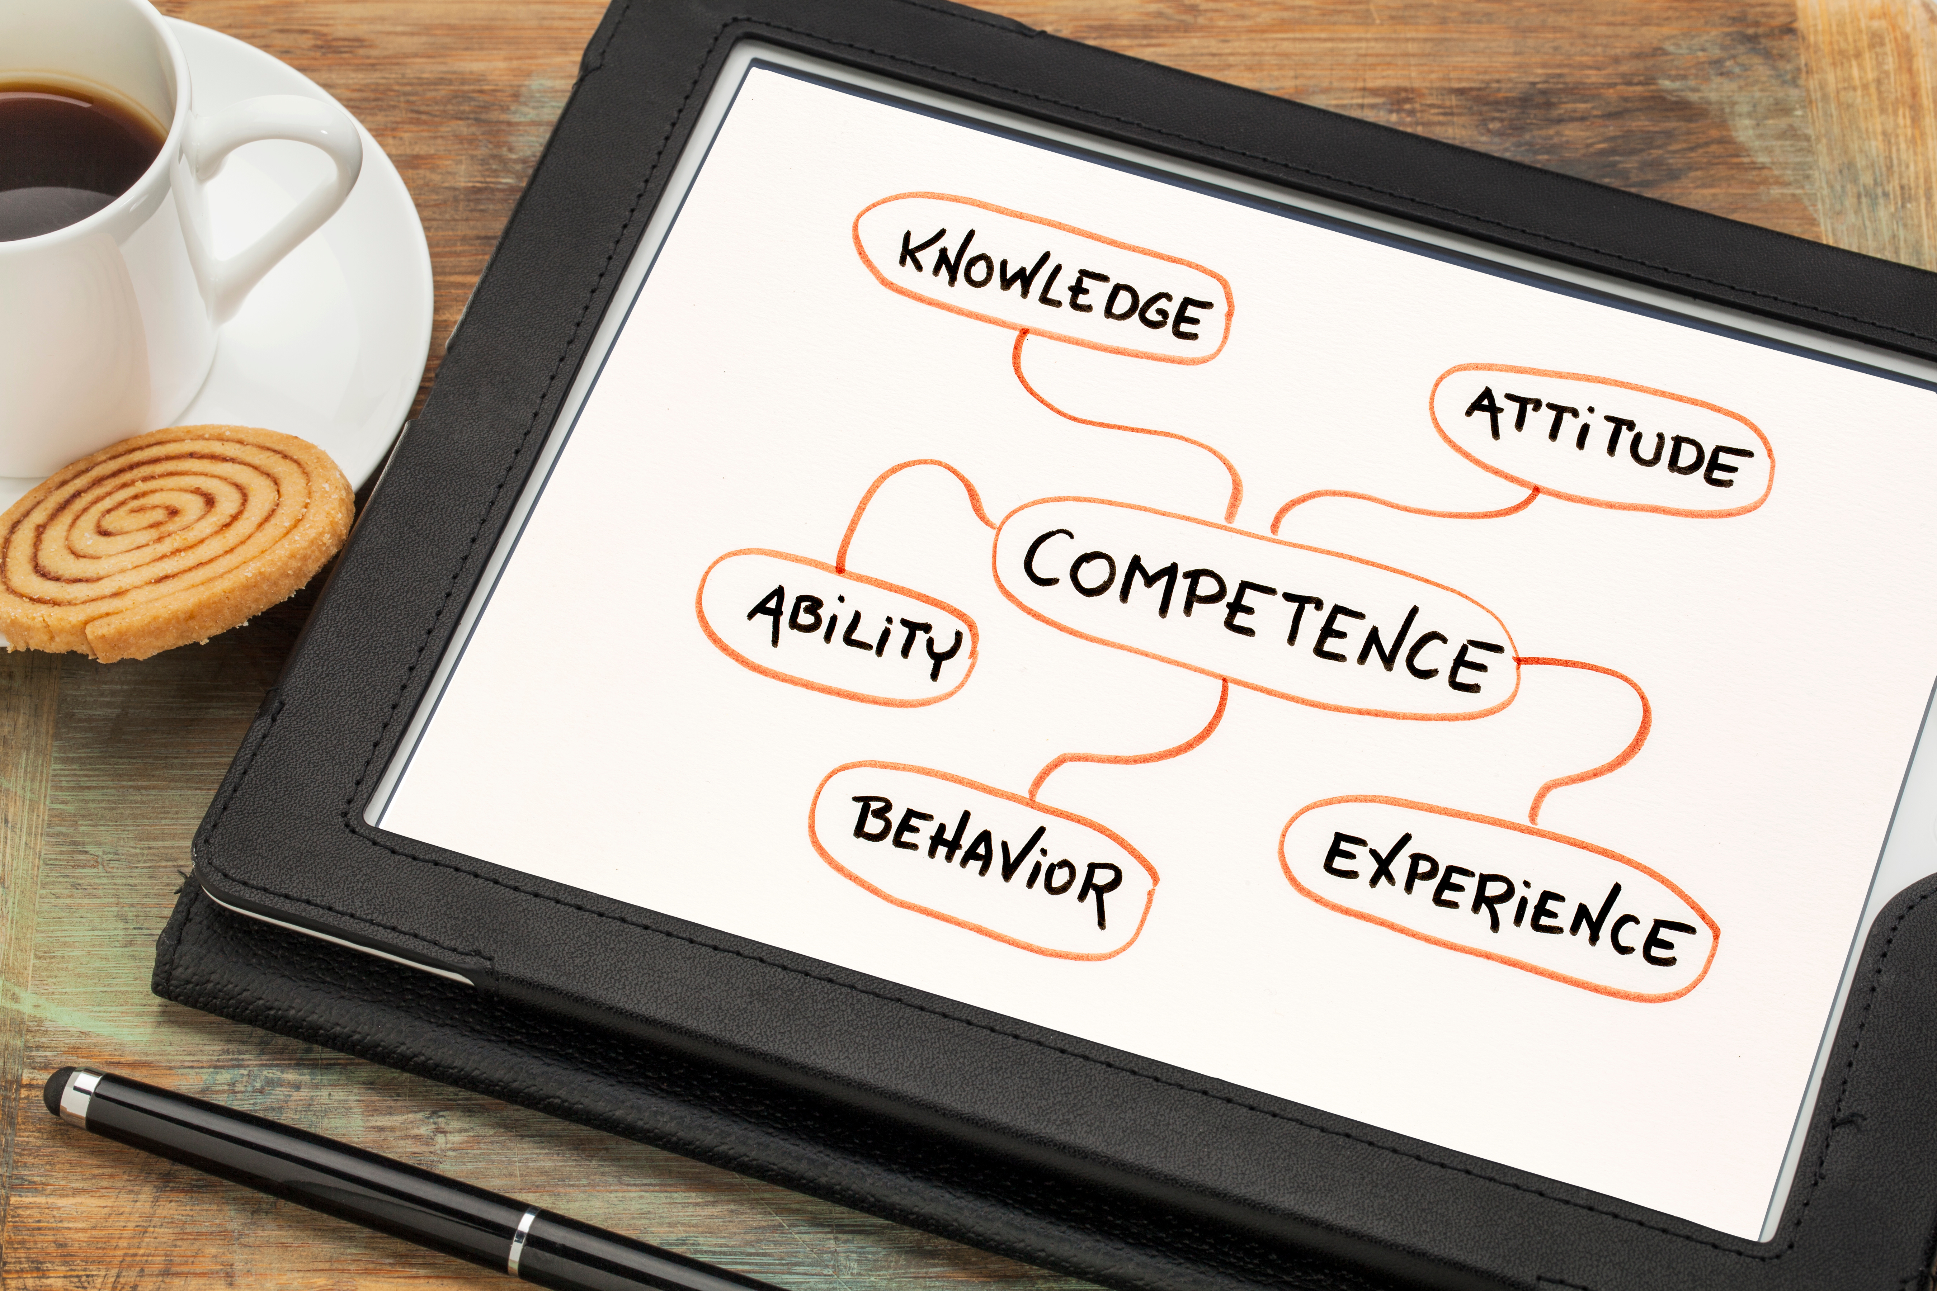
LEVERAGING BEST PRACTICES
AACN Nursing Essentials released 2021
Nursing Education for the 21st Century – “Work-Ready”
Competency-Based Education
Competency-Based Learning (CBL)
Defined program of study driven by learning outcomes (outputs or being practice ready) and observable and measurable competencies to which students are accountable for mastery and which require demonstration of increasing complexity and integration.
Competency
experience, knowledge, ability, attitude, behavior, and skill needed to perform a task.

Slide 5
SUPPORTING PRACTICE READINESS
Practice-Ready Program Outcomes (PRPOs) are central and imperative – verified by practice partners
Assessments are reliable, performance centered, occur as learners progress, and are based on set competencies
Focus is on mastery … Not how long it takes to learn
Students are held accountable for their own mastery
Students are the center of learning

Slide 6
BACKWARD DESIGN

Slide 7
COURSE ALIGNMENT
The process of ensuring that all elements of a course build upon each other. Course elements work toward facilitating the achievement of the Practice Ready Program Outcomes through course objectives, student learning outcomes, and module outcomes.
Learning Materials
Student Learning Outcomes (SLOs)
Module Outcomes (MOs)
Practice Ready Program Outcomes (PRPOs)
Course Objectives (COs)
Course Description
Learning Activities
Formative / Summative Assessments

Slide 8
COURSE ALIGNMENT EXAMPLE

Slide 9
PROGRAM/COURSE MAPPING
A visual representation of the program/course alignment and where student learning outcomes occur and are assessed across the program and courses.
Program/course mapping is used to identify connections, intentional redundancies, non-intentional redundancies, gaps, and opportunities for scaffolding.

Slide 10
COURSE MAPPING

Slide 11
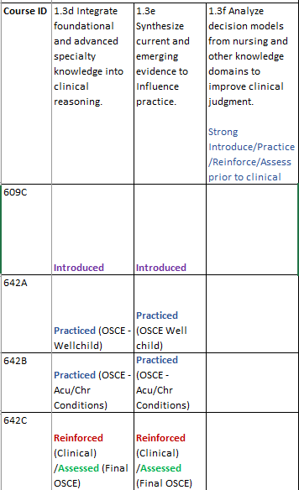
PROGRAM MAPPING
Learning Progression
Introduce: outcome is introduced to students (example: readings, lecture).
Practice: outcome is reinforced, and students are afforded opportunities to practice (example: class activity or graded assignment).
Reinforce: intentional reinforcement.
Assess: evidence collected and evaluated for program-level assessment.

Slide 12
Assessment OF-FOR-AS Learning
Assessment‐OF‐Learning: Summative Assessment comparison of pre-post knowledge
Example: NCLEX or Certification exam (Practice exams)
Assessment‐FOR‐Learning: Formative assessments during learning
Example: Course-level assessments (worksheets, quizzes, etc.)
Assessment‐AS‐Learning: Students reflect on their own knowledge, skills, abilities
Example: Program Evaluation & Reflection – students know and do

Slide 13
SUMMATIVE AND FORMATIVE

Slide 14
Thank You

