Slide 1
Wait, Is QR Supposed To Be Here?
Quantitative Reasoning in the Humanities
March 21, 2024

Slide 2
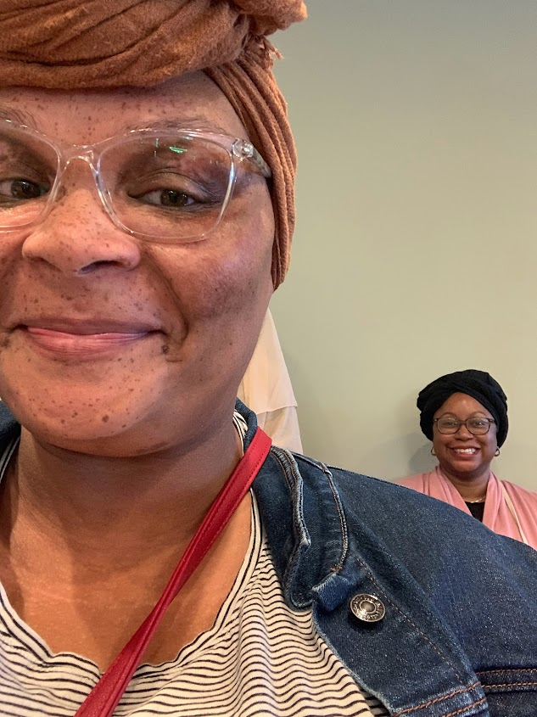
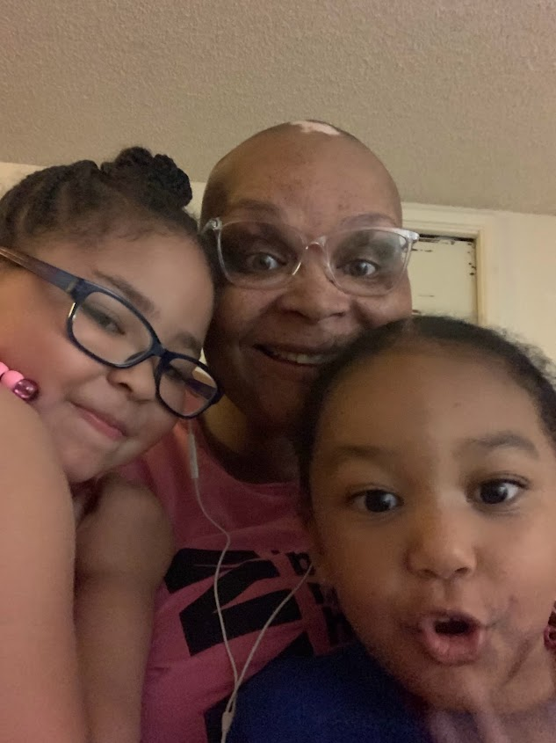
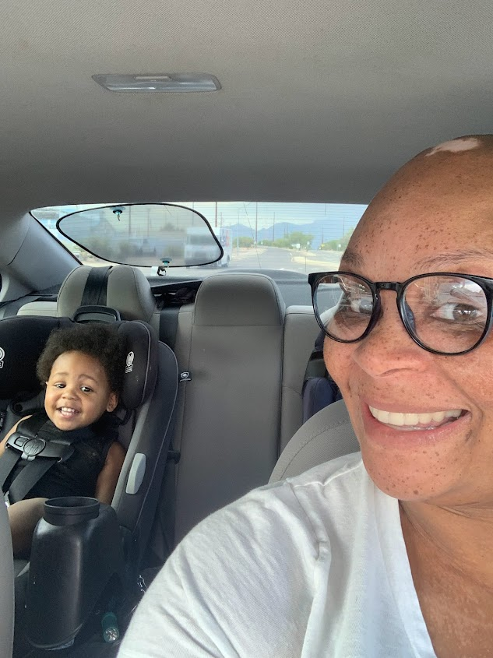
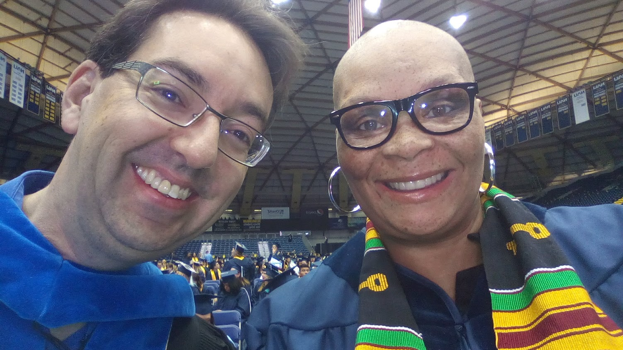
Who am I and What do I teach?
Dr. Treya [TREE-YUH] Allen
UA Gen Ed DEI-Focused Instructional Support Coordinator
Part-Time Faculty
Teaching
African American Studies
Civic Engagement
GE Experience
Student Success/Development

Slide 3
Erin what is QR? How can we use this attribute across disciplines beyond science?
These are great questions Treya. Let’s get into it.

Slide 4
The Quantitative Reasoning attribute in GE helps students to understand quantitative information toward the goal of formulating and supporting ideas. It requires faculty and students to analyze and interpret real-world quantitative information in the context of a discipline or interdisciplinary problem, and to draw conclusions that are supported by evidence.
The Quantitative Reasoning attribute aims to apply those mathematical skills to questions, ideas, challenges, and/or problems that are relevant to students, society, and/or the world.

Slide 5
Ultimately, the application of QR in any course requires:
-Demonstrated competency in working with quantitative information.
-Generating ideas supported by quantitative evidence.
-Assessing the relevance of data and associated implications.
-Communicating those ideas using various formats.

Slide 6
“The great force of history comes from the fact that we carry it within us, are unconsciously controlled by it…History is literally present in all that we do.”
James Baldwin
How can I apply QR to my AFA courses?

Slide 7
How can we explore the slave trade beyond 2-D documents and treatments?

Slide 8
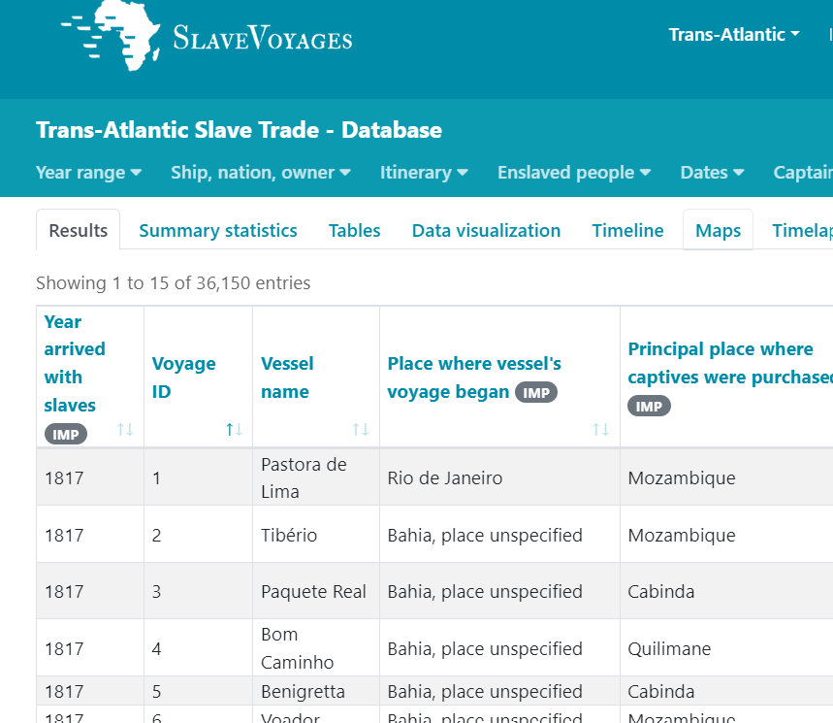
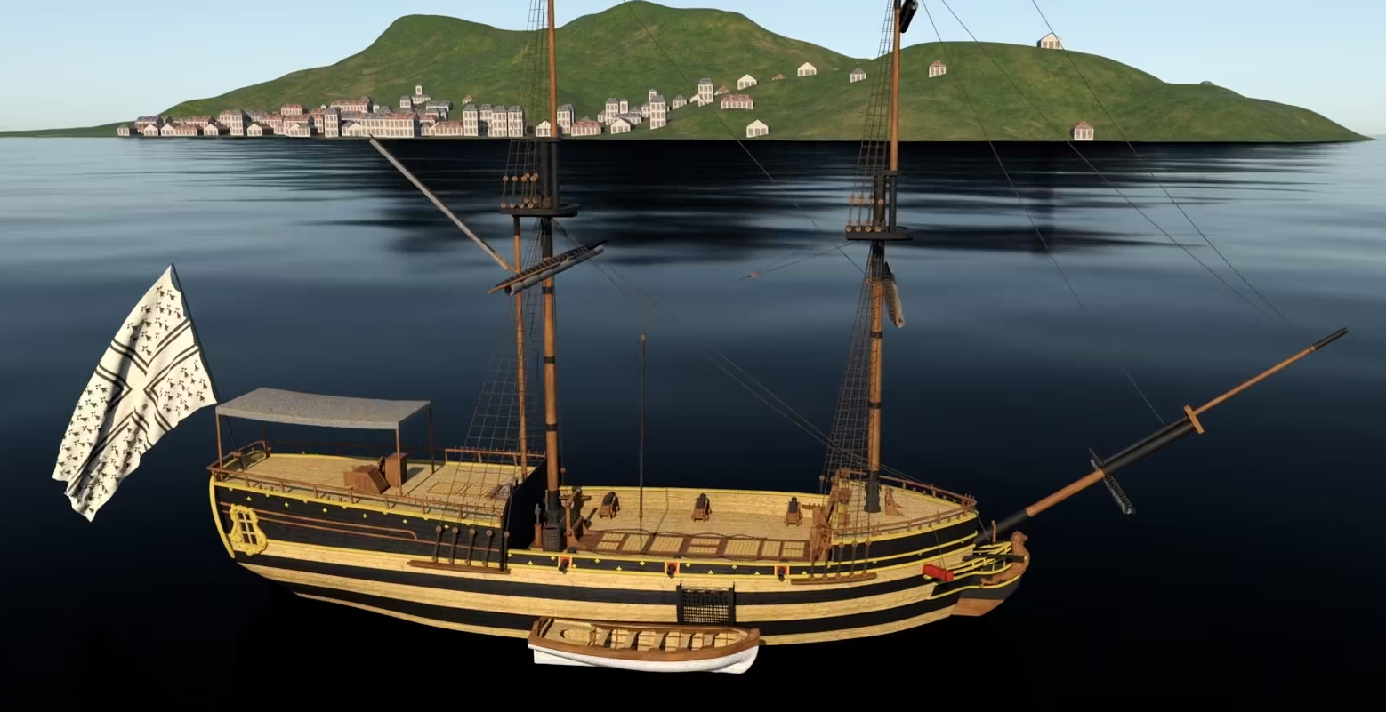
This exercise required students to
Work with numerical data to better understand the human experience of enslaved persons.
Generate ideas and make inferences from the data concerning the volume and massive enterprise of the trans-atlantic slave trade
Work with visual data.
Communicate their findings.

Slide 9
Student Experience 1
“Completing this assignment was difficult emotionally. It was scary to view and read the details of the voyages, and the number of people that were enslaved became very real. I was devastated, and had a sense of panic. I reviewed the names of captains and areas that they had disembarked in Mexico, America, and several other countries. I searched for my family's last names under the captains. Not knowing what I was going to find and what it would all mean. I even felt that I may find my married name and first name of one of my son’s on the list under captains since I have been told that my husband's family was originally from Spain.”
-Student 1

Slide 10
Student Experience 2
“Once I got passed the feeling of “all about me”, then I was able to read the details of the enslaved numbers, and percentages of men, women, and children. I was heartbroken for all the families that were separated, the immoral conditions that the [en]slaved had to endure for almost a year if they survived the voyage. I wondered if they could bathe, but quickly reminded myself that they couldn’t even have restrooms, and were treated worse than animals, so the answer had to be no.”
-Student 2

Slide 11
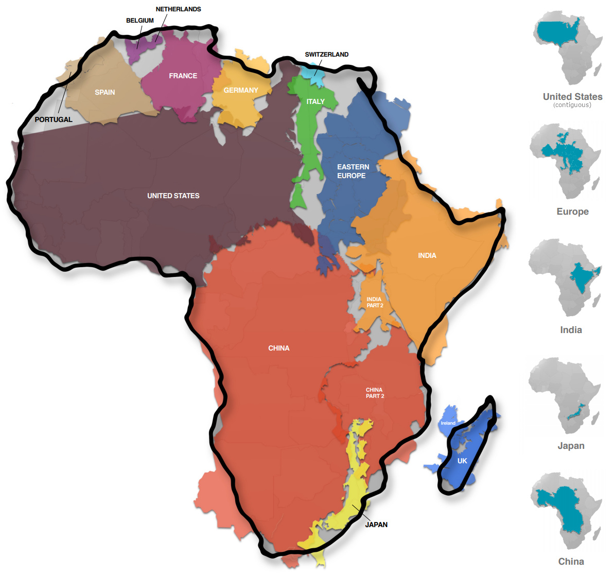
Additional QR Applications In AFA
Measuring Africa
Analyzing the Slave Bible
Calculating the wealth of Mansa Musa
Analyzing Under-developed vs Developing Countries

Slide 12
Interested in learning more? Contact us!
Erin Galyen, Ph.D.
egalyen@arizona.edu
Treya Allen, Ed.D.
treya@arizona.edu

